Slide 1
Employee Retention Intelligence System
The Business Problem:
- High employee turnover increases recruitment costs and disrupts productivity.
- Current HR methods are reactive, not proactive.
The Solution:
- A Machine Learning tool to identify "At-Risk" employees before they leave.
- KPI: Reduce unexpected attrition and save replacement costs.
Reducing Attrition through Predictive Modelling
Presented by: Abdul Rumman | January 2026

Slide 2
The High Cost of Reactive HR
Why we need to predict attrition, not just measure it.
The Financial Blow: According to Gallup (2019), replacing an employee costs 50% to 200% of their annual salary, depending on role complexity.
The Blind Spot: Traditional HR relies on Exit Interviews (Reactive). By the time you know something is wrong, the employee is already gone.
The Goal: Shift from "Damage Control" to "Early Warning" by identifying flight risk before the resignation letter lands.

Slide 3
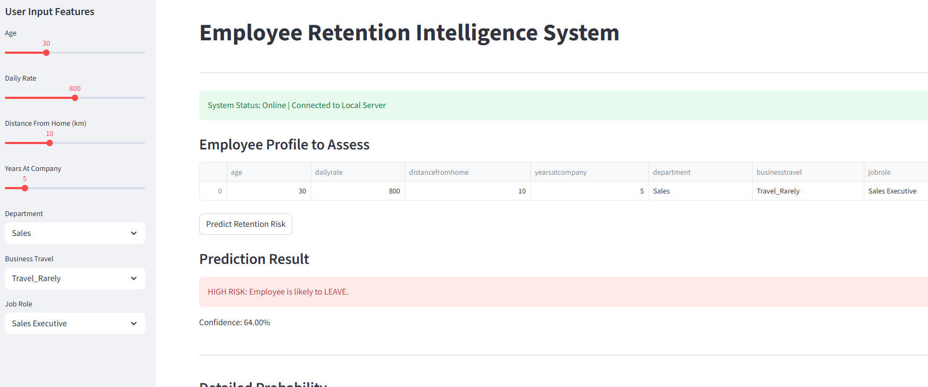
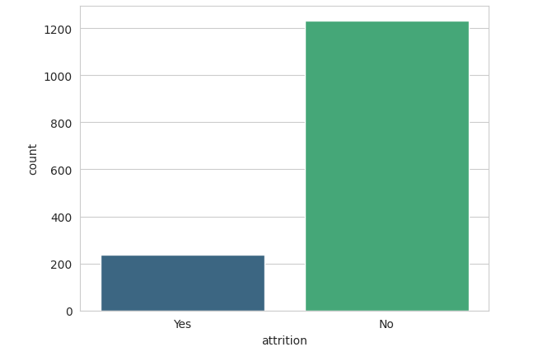
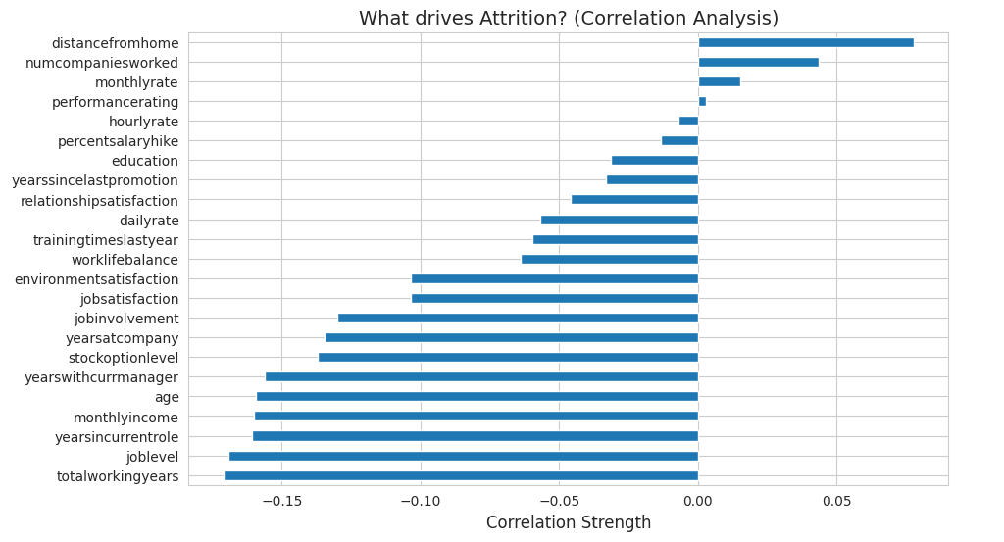
The Dashboard & The Engine
- The Tool: A live "Retention Calculator" that translates 7 user inputs into a retention probability (shown: 64% Risk).
- The Engine: Powered by the Correlation Drivers (Right Bottom) and trained on the Imbalanced Distribution (Right Top) to detect rare attrition events.
- The Logic: Uses "Ghost Column" re-indexing to map simple user inputs to complex training data patterns dynamically.

